Slide 1
WIFI POSITIONING
http://code.google.com/p/wifi-positioning/
PRESENTED BY
DUY NGUYEN
PRATAP KARTHICK
PREMCHANDRAN

Slide 2



Project Idea
Determining the location of the a wifi-enabled device based on Signal Strength
Developing an application on Android OS and experimenting in Nedderman Hall

Slide 3
Starting Point
Signal Strength
MAC address
Triangulation

Slide 4
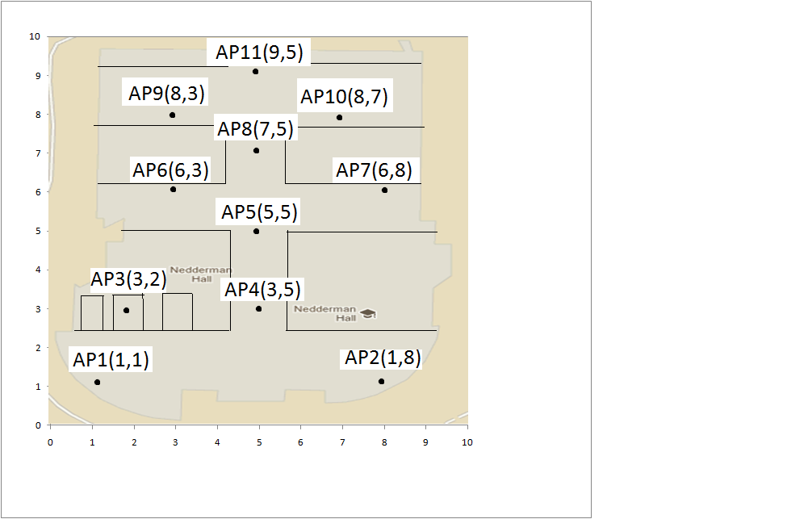
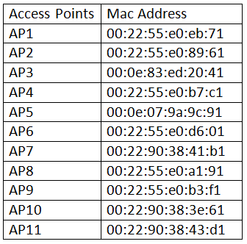
Process
Manually gathering access point approximate locations in Nedderman Hall
Notes:
Reason why the CONST did not work: signal strength depends on many factors, therefore, calculating the distance from the signal strength and a fixed const did not work.

Slide 5
Process (cont.)
Determine the method to calculate distance from Signal Strength
Distance = Signal Strength * A CONSTANT
Gathering signal strength and approximately measure the distance to the access point
Analyzing the result to determine the constant
→ Tools was developed on Android
Actual implementation ➔ CONSTANT did not work
Notes:
Reason why the CONST did not work: signal strength depends on many factors, therefore, calculating the distance from the signal strength and a fixed const did not work.

Slide 6
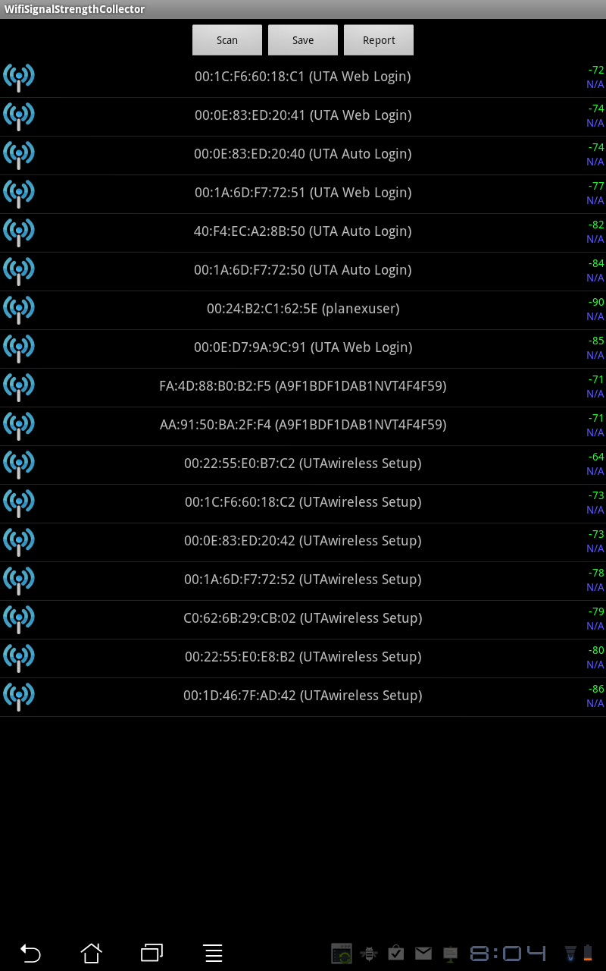
Process (cont.) Tool for Determining Constant

Slide 7
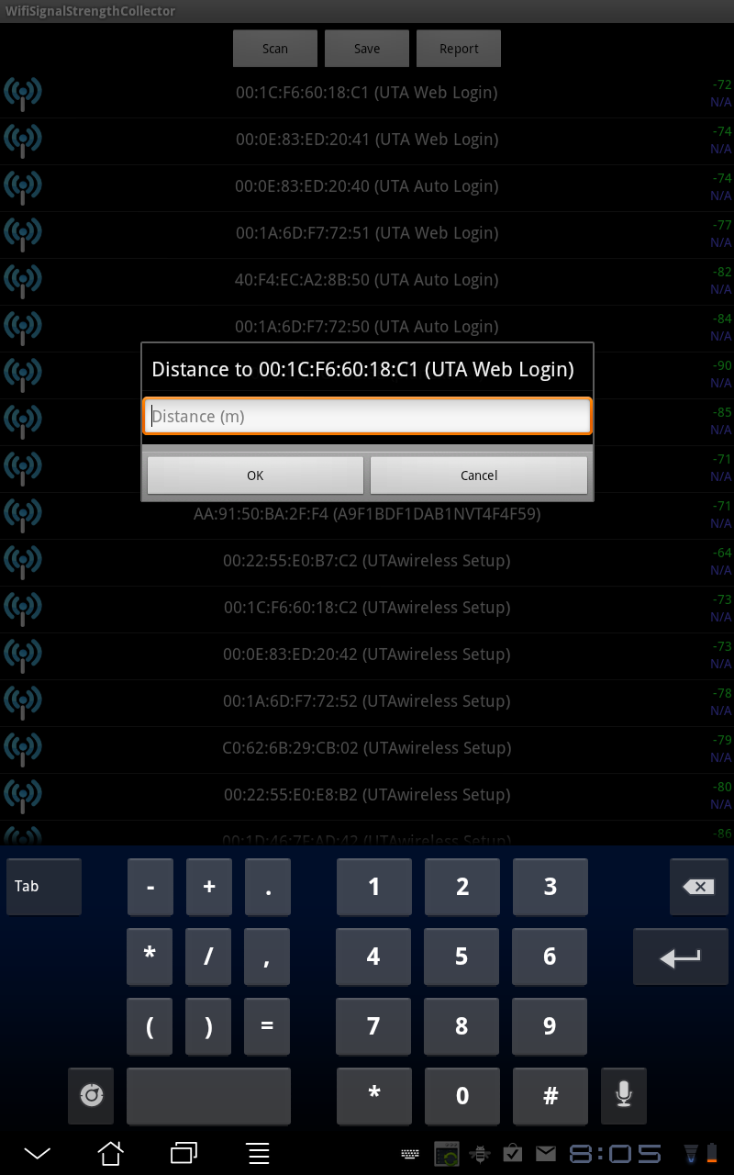
Process (cont.) Tool for Determining Constant

Slide 8
Implementation
Use Android WifiManager to scan the surrounding access points periodically
Order the scanned access points descendingly
Select 3 access points having strongest signal strength
Perform triangulation
Show the result on the screen

Slide 9
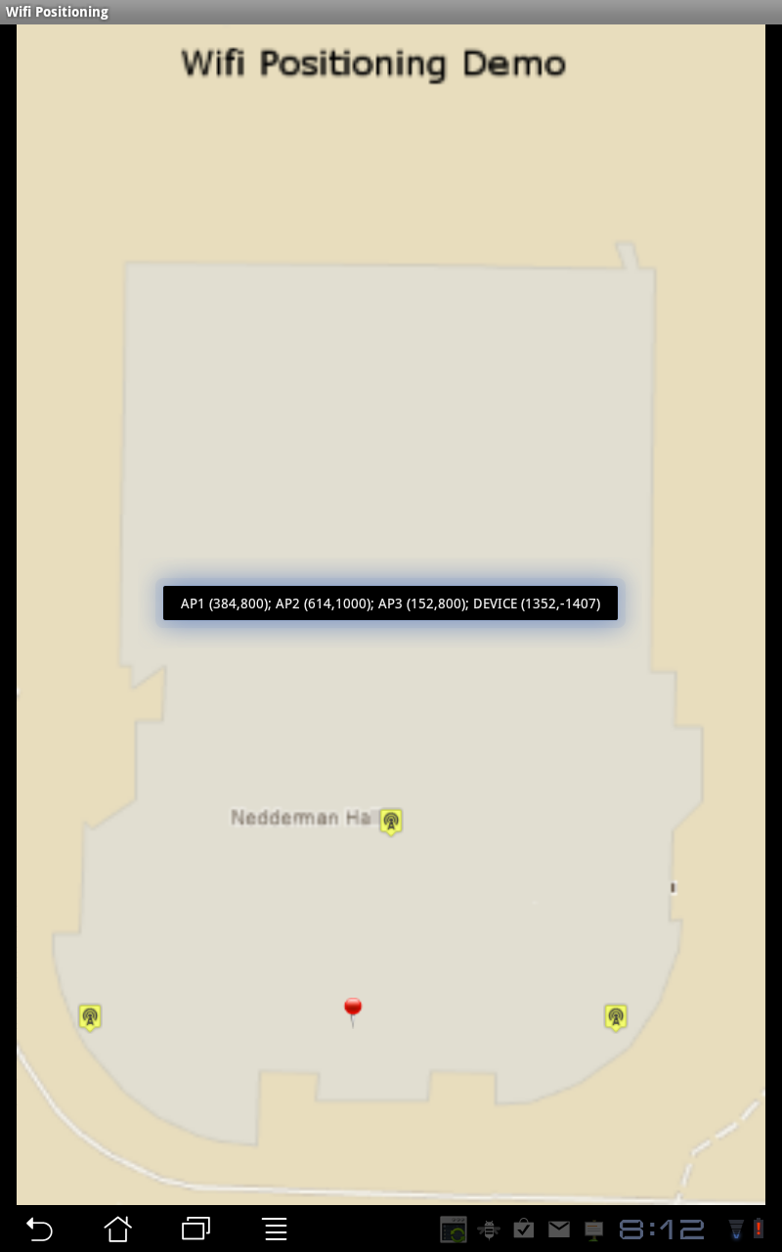
Demo

Slide 10

Future Works
Better solution to measure the signal strength
Ability to enter Known Access Points to the application
Using better Map system to display the result
Research other methods of indoor positioning

